Slide 1
Product description
Our map is mainly designed for students to locate areas and places around the school. The map can be used by every students so far as students have the app. Students can choose from the following places or locations
Canteen
Library
Classroom building
School museum
Administration block
Bicycle repair shop

Slide 2
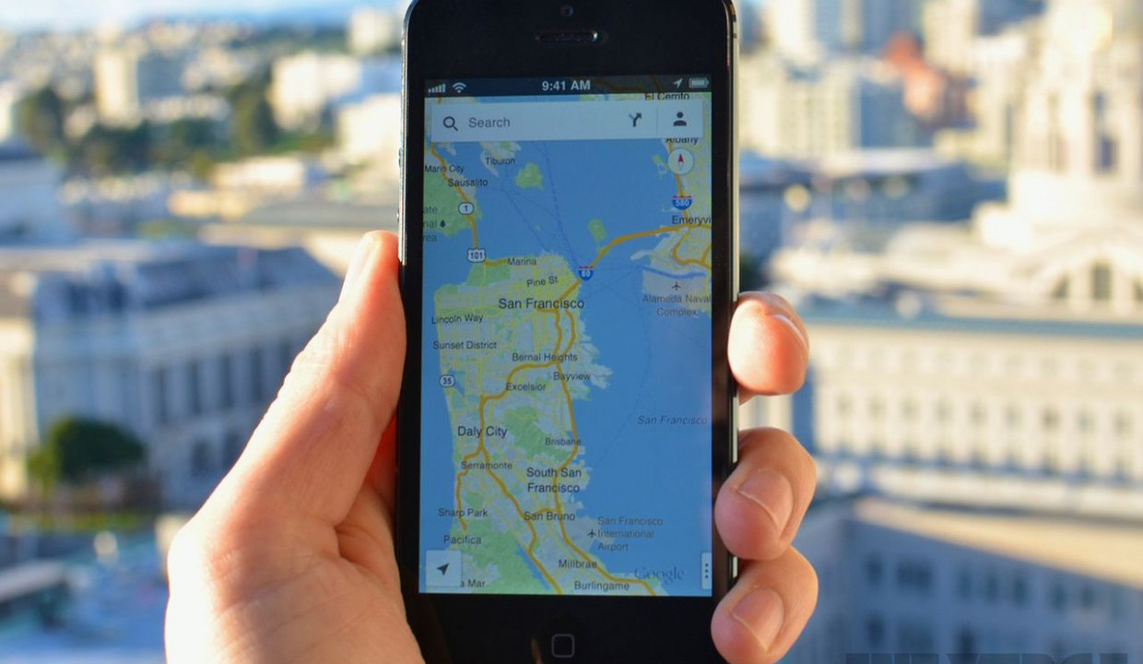
UI DIAGRAMS
This is how our user interface will look after completing our project

Slide 3
use cases
Our app systems looks this way
Check map locations
Select destination
Arrival alert

Slide 4
Process description
Our map describes the workflow diagram to bring forth a clearer understanding of a process or series of parallel processes.
Before we constructed the Process Flowchart we followed some steps
Determine the Boundaries
Where the map begins?
Where the map end?
We then went forth describing how our map would look like
Then we drew the flowchart to show sufficient information in order to understand the general process
after that we finalized our Flowchart by asking among ourselves some ideological questions
Ask if this process is being run the way it should be.
What is redundant; and what is missing

